Slide 1

NNEIDS Fall Update
ID Week 2025
October 20, 2025
Atlanta, GA

Slide 2
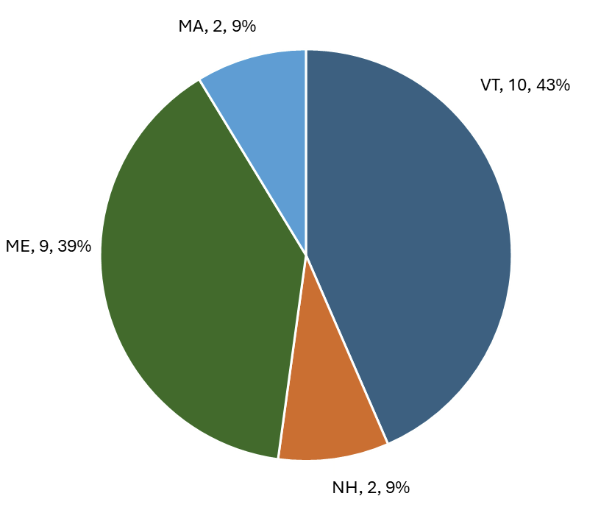
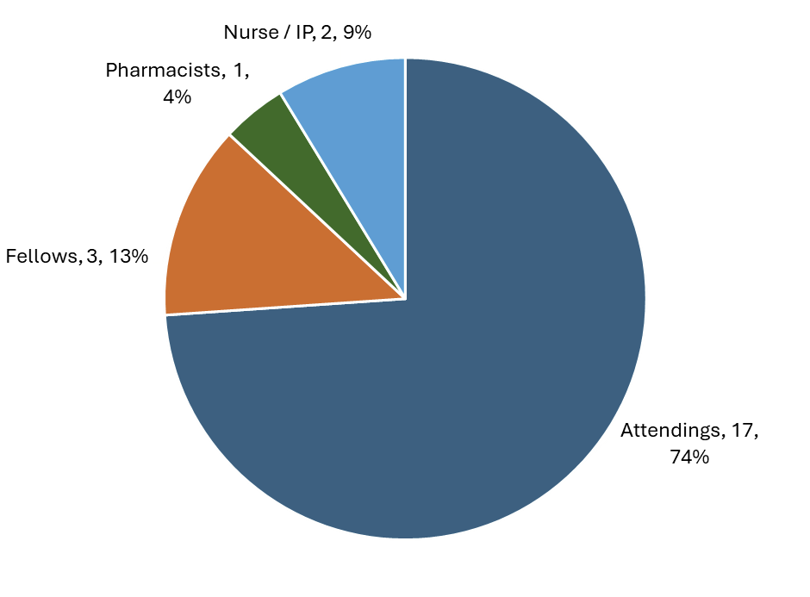
Membership
23 total members as of 10/20/2025

Slide 3
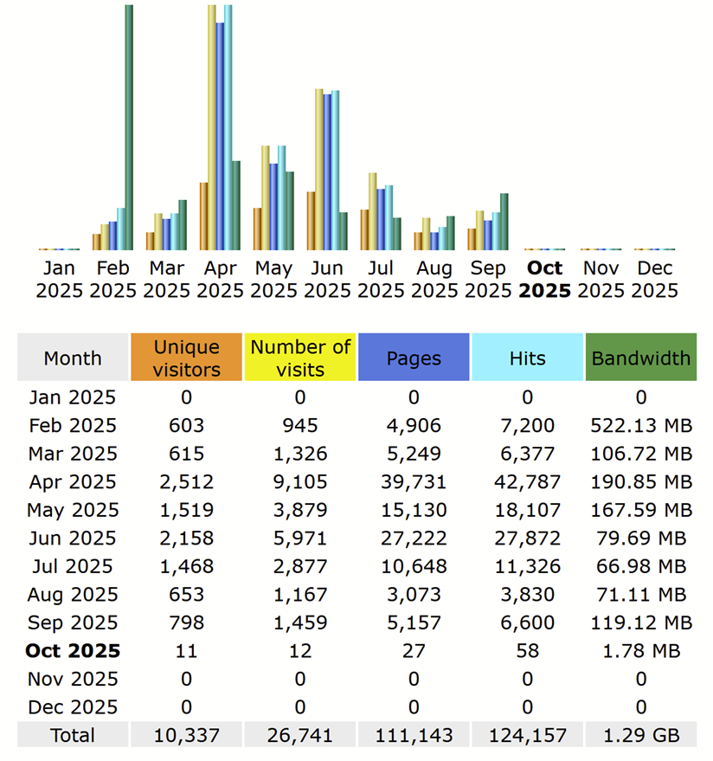
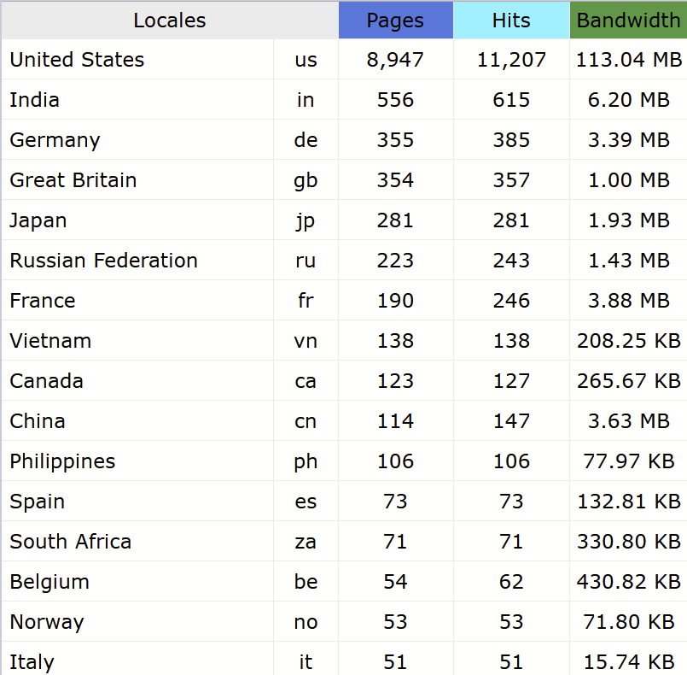
Site traffic

Slide 4
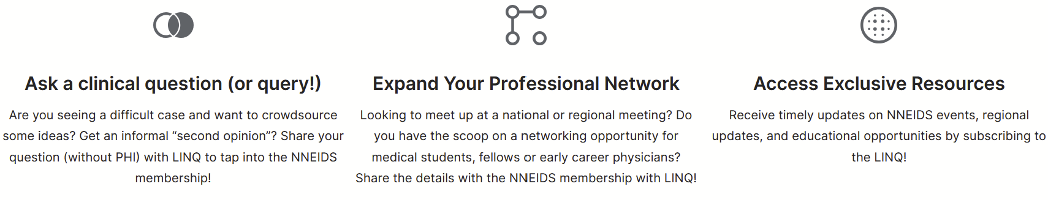
Welcome to the LINQ
The Listserv for Information, Networking and Queries
https://nneids.org/join-the-linq/

